Slide 1

MIS MINERS
Loan Outcome
Prediction
To Default
Or not default?
That is the question.
MIS 545

Slide 2






TEAM
Prakhar Jain
Pourush Kalra
Prathamesh
Ranade
Pu Sun
Shengtao Li
Trupti Parkar

Slide 3





AGENDA
problem description
dataset description
Data preprocessing
ALGORITHM IMPLEMENTATION & Improvement
Results and evaluation

Slide 4
01
UNDERSTANDING THE PROBLEM

Slide 5


What IS THE Lending Club?
Notes:
Borrowers apply for loan. Investors provide loans to borrowers in exchange for the promise of repayment with interest. That means the lender only makes profit if the borrower pays off the loan. However, if he/she doesn’t repay the loan, then the lender loses money.

Slide 6
PROBLEM STATEMENT
Close to $170 Billion worth of loans default in the US every year
Defaults cause extensive harm to the Bank and the economy
Default
Or
Not Default?
To predict whether a person who takes a loan from ‘The Lending Club’ will
Using Parameters such as:
Annual Income, Home Ownership Status, Length of Employment

Slide 7
CURRENT STATE OF DOMAIN DESCRIPTION
Paper | Classifier | Performance Metrics | Score | Limitations
Wang et al. (2017) | Decision Tree | Accuracy | 95% | -
Han, Choi and Kim (2018) | Logistic regression | Accuracy | 69.7 % | Reduces performance in datasets with huge number of variables due to on linear relation between them
Byanjankar, Heikkila and accurate results Mezei (2015) | Neural network | Accuracy | 74% | Requires larger training sets to give better results.

Slide 8
02
DATASET DESCRIPTION

Slide 9


DATASET DESCRIPTION
Source: Kaggle
36
Categorical
2.2 MN
Instances
145
Independent
Variables
109
Numerical
Loan Amount
Interest Rate
Employment Length
Home Ownership Status
Annual Income
Accounts opened
in past 24mths
Loans issued through 2007-2018
Including data on:
Loan status, Payment Information,
Applicant’s Financial Status

Slide 10
03
Data Preprocessing

Slide 11
Data PREPROCESSING
Remove columns with significant missing values
Clean the irrelevant value
Create a new target variable based on Default and Non-Default categories
Create new factor variables
Review variables

Slide 12
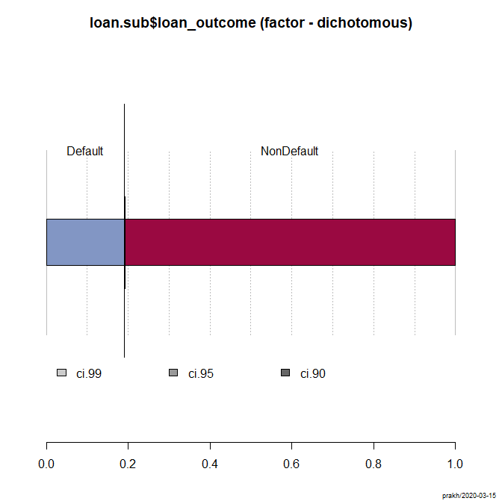
DATA TRANSFORMATION EXAMPLE: LOANSTATUS
AFTER
BEFORE

Slide 13
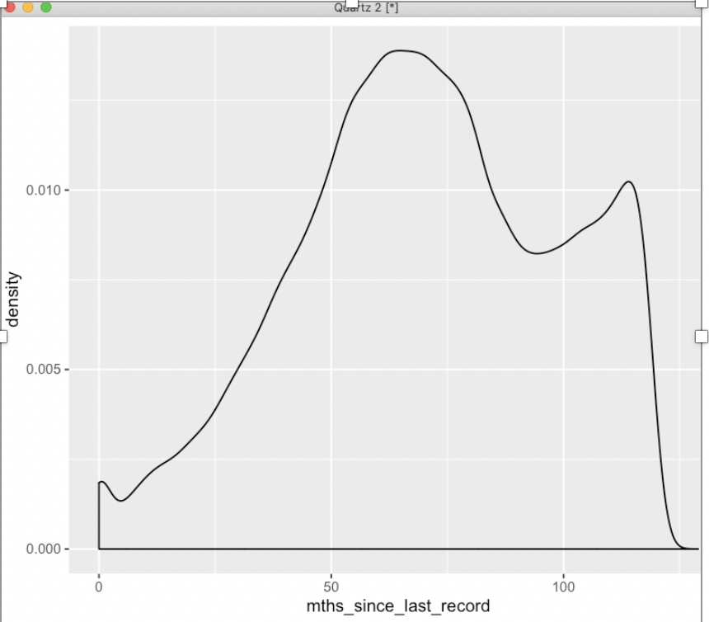
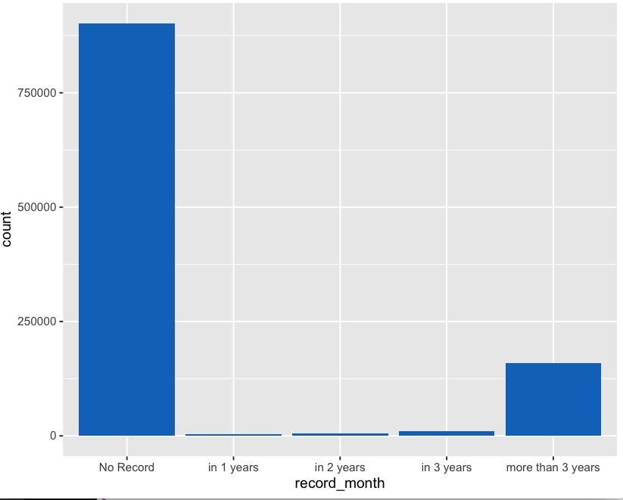
DATA BINNING EXAMPLE: Months since last record
BEFORE: NUMERICAL VALUES
AFTER: TURNED into CATEGORIES

Slide 14
DATA PREPROCESSING RESULTS
Number of Attributes
145 65
Total Instances
2.2 M 1.18 M

Slide 15
04
ALGRORITHM IMPLEMENTATION & Improvement

Slide 16
Initial ALGORITHM implementation on partial datasets
(Stage 2)
Sensitivity: Default
Specificity: NonDefault

Slide 17
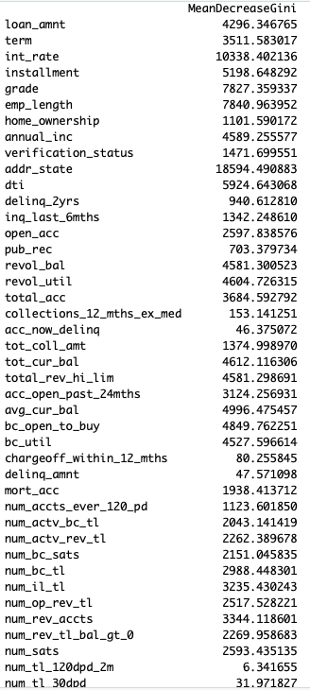
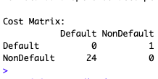
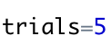
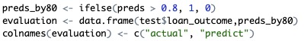
METHODs OF OPTIMIZING MODELs
Aim: Improve Sensitivity
Actual
Use Random Forest Algorithm to select top valuable attributes
Set new
Threshold
Set an Error Cost Matrix
Iteration & Boosting
Predicted

Slide 18
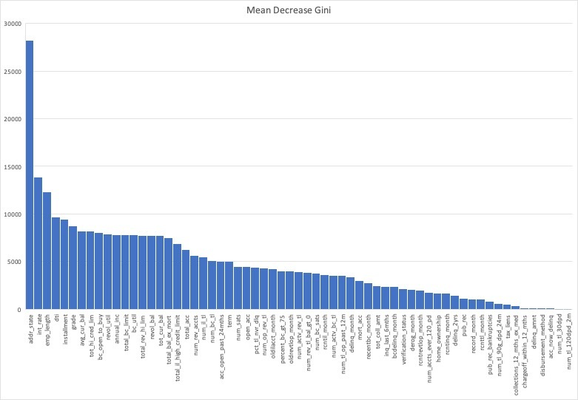
ATRRIBUTE SLECTION USING RANDOM FOREST
64
Independent
Attributes
17
Independent
Attributes

Slide 19
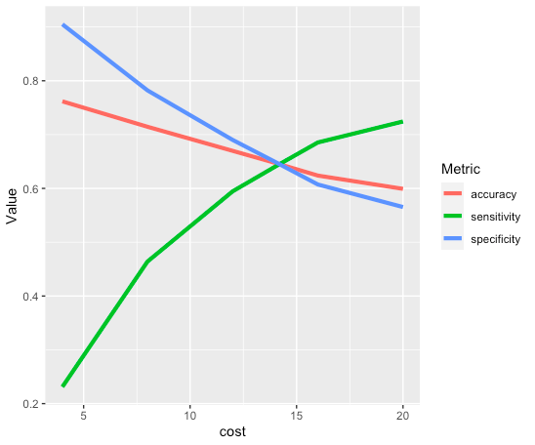

Improving c5.0 Decision Tree
Aim: To Improve Sensitivity
Used a loop to find the best error cost matrix
Accuracy: 61%
Sensitivity: 71%
Specificity: 58%
The optimal error cost of false negatives is:
18

Slide 20
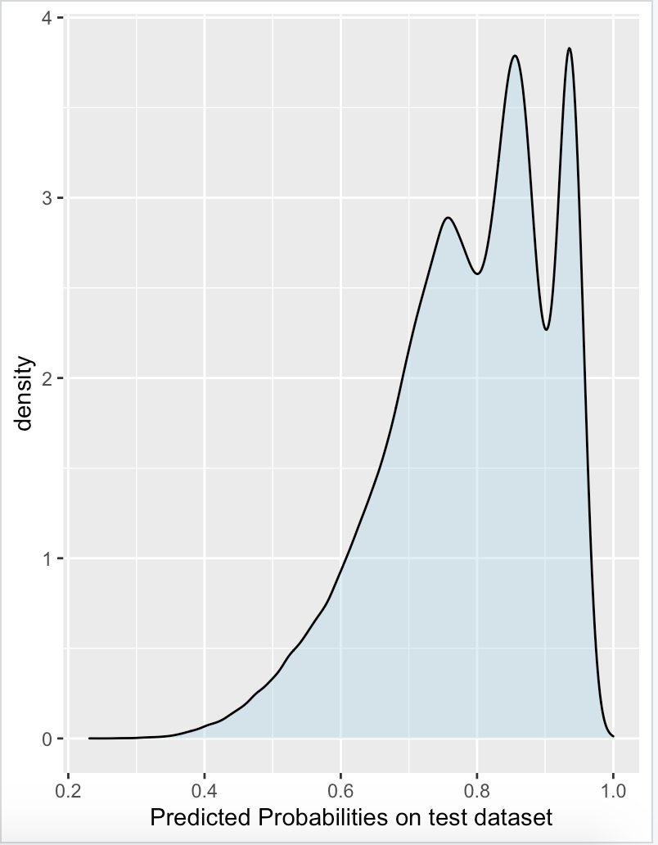
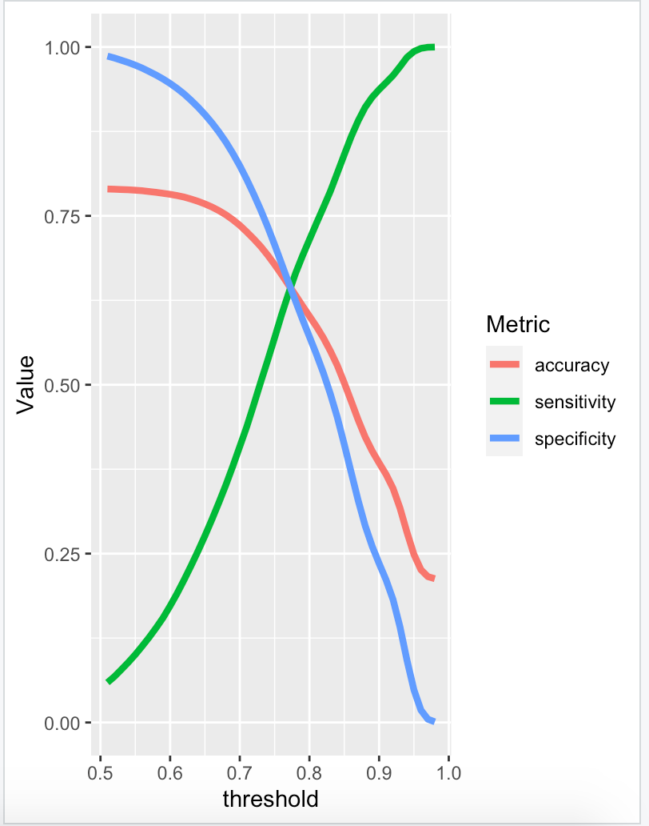
Improving Logistic Regression
Aim: To Improve Sensitivity
Distribution of predicted probabilities
Used a loop to find the best threshold
Accuracy: 60%
Sensitivity: 71%
Specificity: 57%
Most suitable threshold :
0.8
Default: 0
NonDefault: 1
Default threshold is 0.5

Slide 21
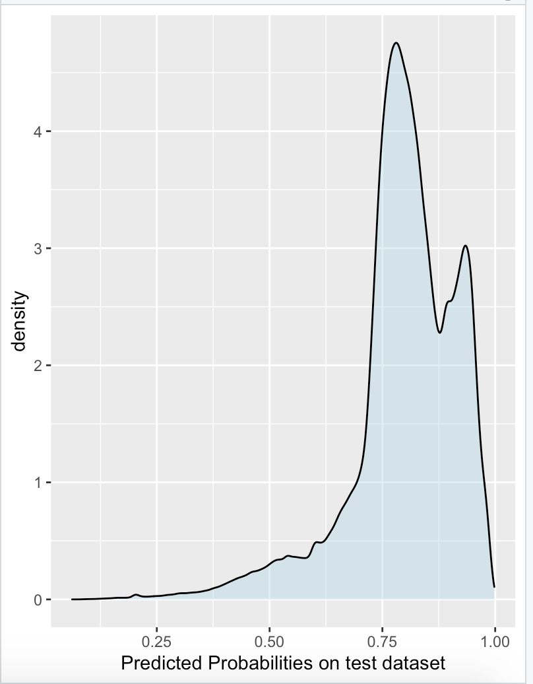
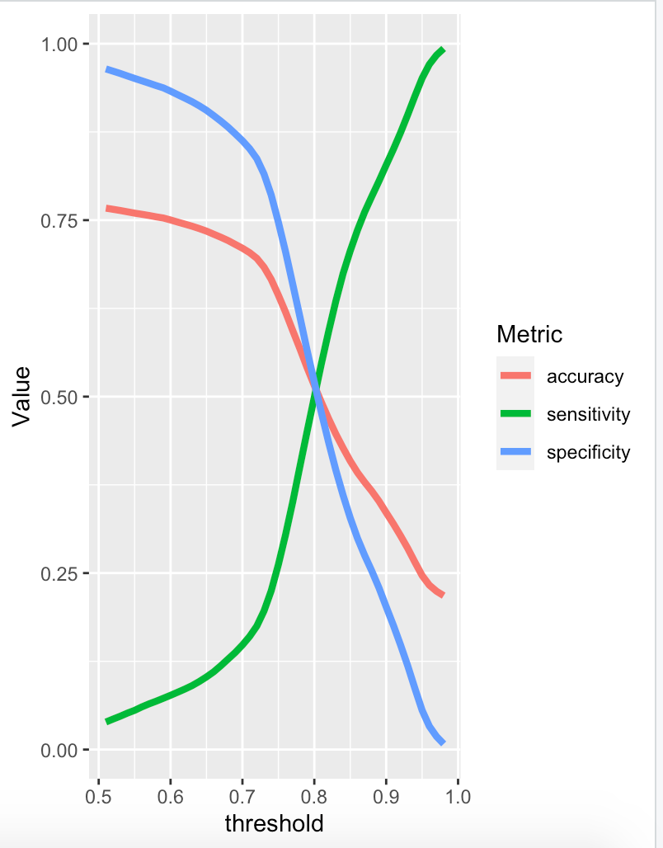
Improving Neural Networks
Aim: To Improve Sensitivity
Distribution of predicted probabilities
Used a loop to find the best threshold
Accuracy: 52%
Sensitivity: 50%
Specificity: 52%
Most suitable threshold :
0.8
Default: 0
NonDefault: 1

Slide 22

05
Final Results and Evaluation

Slide 23
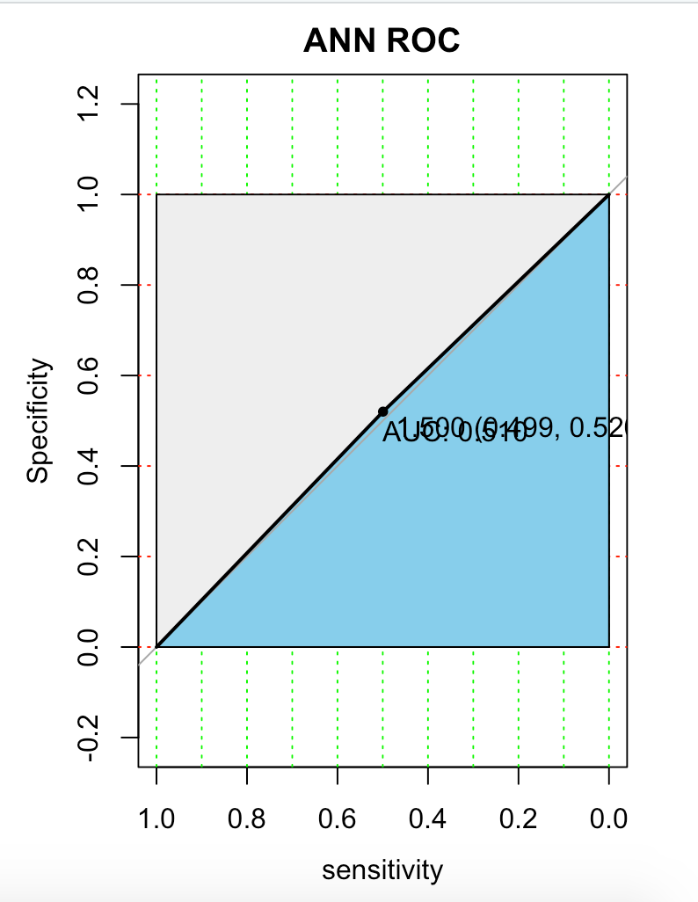
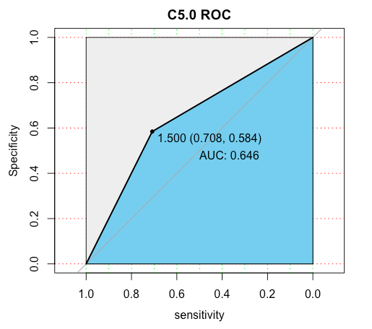
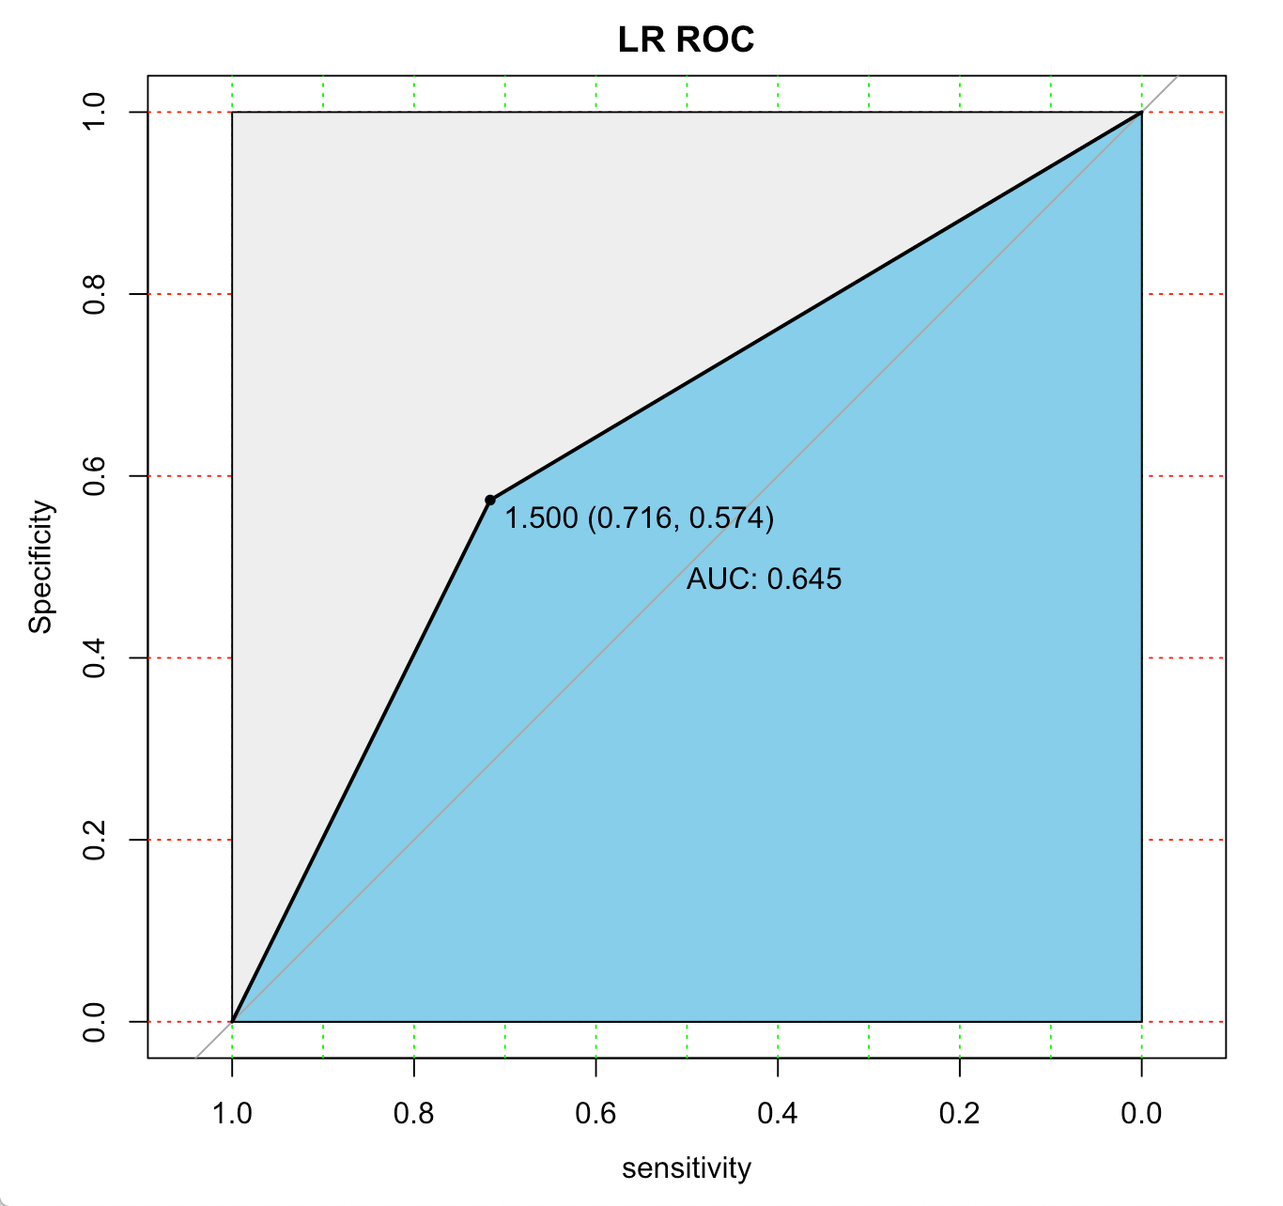
Final results of SELECTED ALGORITHMS
Used a loop to find the best error cost matrix
Used a loop to select the best threshold
Neural Network
C5.0 Decision Tree
Logistic Regression

Slide 24
EVALUATION OF the PROJECT
Project Strengths:
High Applicability in real world
Largescale dataset with 100+ independent variables and 2MM+ instances
Practical correlation between the three evaluation metrics
Project Limitations:
Severely Imbalanced Dataset
Inefficient Predictor Variables
Nature of Dataset (People’s Behavior)
71% Sensitivity
61% Accuracy
58% Specificity
C5.0 Decision Tree
Notes:
The majority class baseline is 78%, which is worse than the criterion(70%-30%)

Slide 25


THANK YOU!
QUESTIONS

